Slide 1
Windows Tech Series Advanced Client Management
Speaker 1
Title
Speaker 2
Title

Slide 2
Agenda
Day | Day 1 Deployment | Day 2 Management | Day 3 Security | Day 4 Windows for CSP
 |  |  |  | Deployment | Management | Security
Synopsis | Module 1 – Introduction | Module 1 – Base System Setup | Module 1 – Analysis Of Common Threats | Module 1 – Windows for SMB Partners
 | Module 2 – Applications & Updates | Module 2 – Configuration | Module 2 – Hardening Windows | Module 2 – Windows Ent. Subscription
 | Module 3 – Windows as a Service (WaaS) | Module 3 – Managing Client Devices | Module 3 – Advanced Threat Protection | Module 3 – Deployment
 | Module 4 – Browsers & Internet Security | Module 4 – Advanced management options I | Module 4 – Information Security (RMS/EDP) | Module 4 – Managing Updates
 | Module 5 – Secure Boot & Device Guard | Module 5 - Advanced management options II | Module 5 – Internet Security

Slide 3
Part 5 – Advanced Client Management
Managing Endpoint Protection/Defender with Config Manager
Enroll Client in Configuration Manager through MDM
MDM Policies in Configuration Manager

Slide 4

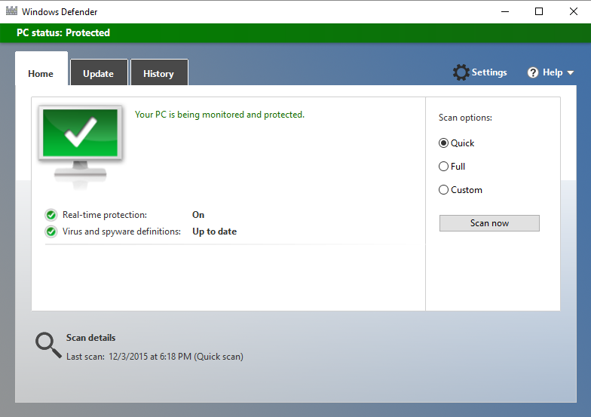
Endpoint protection
SECURE AND IMPROVE PRODUCTIVITY
Directly manage Windows Defender in Windows 10
Continue to use SCEP for Win7/8.x
Common antimalware platform between Defender and SCEP
Consistent management experience from admin console
Policy settings for anti-malware and Windows Firewall
Malware detection state, email alerts, and remedial actions
Centralized dashboard and reports
Engine and definition updates via software update management
Notes:
The unification of the infrastructure also includes bringing the endpoint protection management capabilities within the client management frame. Through the single Configuration Manager administration console, the admin can deploy System Center Endpoint Protection and easily track the health and state of the endpoint clients.

Slide 5
Management Labs Module 05-01: Managing Endpoint Protection/Defender with SCCM

Slide 6
Manage Windows 10 devices via on-premises MDM
On-premises network
FUNCTIONALITY
Ability to manage Windows 10 devices
Per-user device enrollment
Bulk enrollment
Settings and policies
Required app deployment
Software deployment
Resource access profiles
Device wipe and retire
Policies
New features
Windows 10 PCs and mobile devices
(with MDM-style management of PCs)
ConfigMgr
SQL
Data
ConfigMgr console
Example scenarios: IoT/embedded devices, highly regulated customers
Notes:
Here we are showing the new option that we will be providing hybrid customers that want to manage their Windows 10 devices with on-premises infrastructure.
In this scenario, Windows 10 PCs and mobile devices will be managed via lightweight, MDM-style management. This is similar to our existing hybrid deployment option (an Intune subscription will be required for MDM/MAM). Hybrid customers will be provided with a choice as to how they want to manage their Windows 10 devices (connected to the cloud or via on-premises infrastructure). In either scenario, the feature updates will be delivered via the Intune cloud. The difference here is that with this new option customer data will not be stored in the cloud.

Slide 7
Management Labs Module 05-02: Enroll Client in Configuration Manager through MDM Module 05-03: MDM Policies in Configuration Manager

